Slide 1
Uncertainty Propagation
NEIL LAWRENCE
UNIVERSITY OF SHEFFIELD
@lawrennd
Notes:
Challenges
Introduce self
Alphago impressive but requires heavy compute.
More games of go than any human
And yet still Lee managed to win a match.

Slide 2
GLOBAL INFORMATION STORAGE CAPACITY IN OPTIMALLY COMPRESSED BYTES
SVMs
dominate
NIPS
ConvNets
Developed
Notes:
Superhuman performances are being driven by ML
Vision, Speech, Translation
Lots of process, but driven by availability of data.
Methodologies have not progressed a great deal since late 1990s

Slide 3
Notes:
Historical Analogy
Thomas Newcomen South West England
1712 Steam Engine

Slide 4
Coal
Google
Facebook
Amazon
Tin
Startups

Slide 5
Notes:
People and entire fields are passed by.

Slide 6
Notes:
James Watt Separate Condensor 1760s

Slide 7
Outline of the DeepFace architecture. A front-end of a single convolution-pooling-convolution filtering on the rectified input, followed by three locally-connected layers and two fully-connected layers. Color illustrates feature maps produced at each layer. The net includes more than 120 million parameters, where more than 95% come from the local and fully connected layers.
Source: DeepFace
Notes:
Modern Inference Engine
120 million parameters, 1 billion images, near human performance

Slide 8











$\text{g}\left(x\right)$
${\text{f}}_{1}(x)$
${\text{f}}_{2}(∙)$
${\text{f}}_{3}(∙)$
${\text{f}}_{4}(∙)$
${\text{f}}_{5}(∙)$
${\text{f}}_{6}(∙)$
${\text{f}}_{7}(∙)$
${\text{f}}_{8}(∙)$
${\text{f}}_{9}(∙)$
$\text{g}\left(x\right)={\text{f}}_{9}\left({\text{f}}_{8}\left({\text{f}}_{7}\left({\text{f}}_{6}\left(⋯\right)\right)\right)\right)$

Slide 9
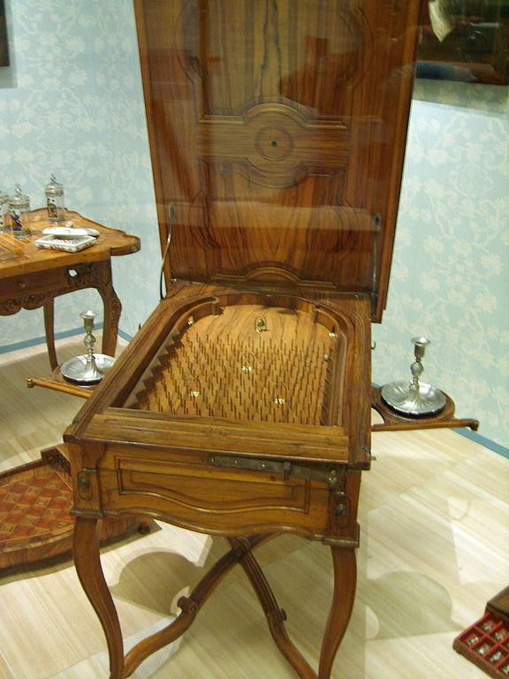
Notes:
Internal structure of the machine like layers of pins
Initial state of machine.
Moving pins around to fix

Slide 10

$f_{9}\left(\text{h}\right)=\left[\begin{matrix}φ\left(\sum_{i}{w_{1i}h_{i}}\right) \\ \begin{aligned}φ\left(\sum_{i}{w_{2i}h_{i}}\right) \\ ⋮\end{aligned} \\ φ\left(\sum_{i}{w_{ki}h_{i}}\right)\end{matrix}\right]$

Slide 11


$f_{9}\left(\text{h}\right)=\text{ϕ}\left(\text{Wh}\right)$
$$\text{W}∈ℜ^{k_{8}×k_{9}}$$

Slide 12





$x$
$$\text{ϕ}\left({\text{W}}_{1}x_{1}\right)$$
$$\text{ϕ}\left({\text{W}}_{2}h_{1}\right)$$
$$\text{ϕ}\left({\text{W}}_{3}h_{2}\right)$$
$$y$$
Yes
No

Slide 13
$x$
$$\text{ϕ}\left({\text{W}}_{1}x_{1}\right)$$
$$\text{ϕ}\left({\text{W}}_{2}h_{1}\right)$$
$$\text{ϕ}\left({\text{W}}_{3}h_{2}\right)$$
$$y$$
Yes
No

Slide 14
B
A
Notes:
All possible paths!

Slide 15



$g(x)$
$$\int{g\left(x\right)p\left(x\right)dx}$$
$$\frac{dg(x)}{dx}$$

Slide 16

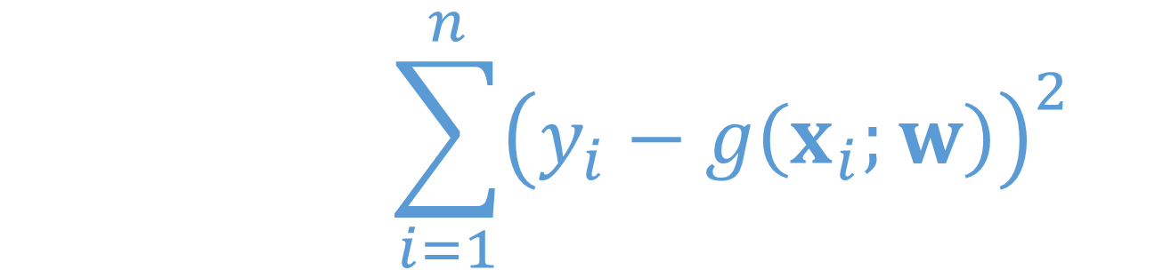
$$E\left(w\right)=\sum_{i=1}^{n}{{\left(y_{i}−g\left(x_{i};w\right)\right)}^{2}}$$
$$\log{p\left(y | w,x\right)}=\frac{1}{2σ^{2}}\sum_{i=1}^{n}{{\left(y_{i}−g\left(x_{i};w\right)\right)}^{2}+\frac{n}{2}\log{{2πσ}^{2}}}$$

Slide 17



$$p\left(y,w | x\right)=\prod_{i=1}^{n}{p\left(y_{i} | w,x_{i}\right)}p\left(w\right)$$
$$x$$
w
y
$$p\left(y|x\right)=\int{\prod_{i=1}^{n}{p\left(y_{i} | w,x_{i}\right)}p(w)dw}$$

Slide 18





$$\log{p\left(y | x\right)}≥∫q\left(w\right)\log{\frac{p\left(y | w,x\right)p\left(w\right)}{q\left(w\right)}dw}$$
$$ℒ\left(y | x\right)=∫q\left(w\right)\log{\frac{p\left(y | w,x\right)p\left(w\right)}{q\left(w\right)}dw}$$
$$\log{p\left(y | x\right)}$$
$$KL\left(q\left(w\right) | p\left(w | y,x\right)\right)$$
$$ℒ\left(y | x\right)$$

Slide 19
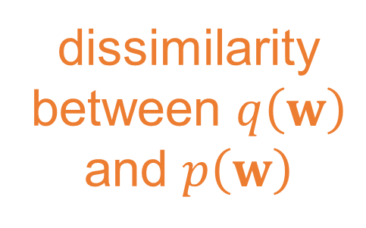

dissimilarity between $q\left(w\right)$ and $p\left(w\right)$
expected
log likelihood
$$ℒ\left(y | x\right)={\left\langle \sum_{i=1}^{n}{{\left(y_{i}−g\left(x_{i};w\right)\right)}^{2}}\right\rangle }_{q\left(w\right)}−KL\left(q\left(w\right)|p(w)\right)+const$$
$$ℒ\left(y | x\right)={\left\langle \log{p\left(y | w,x\right)}\right\rangle }_{q\left(w\right)}−KL\left(q\left(w\right)|p(w)\right)$$

Slide 20






Gaussian Processes
$$x_{1},y_{1}$$
$${x_{2},y}_{2}$$
$$p\left(f | x\right)$$
$$p\left(y_{1}|f_{1}\right)$$
$$p\left(f|y,x\right)$$
$$p\left(y_{2}|f_{2}\right)$$

Slide 21
$\text{g}\left(x\right)$
${\text{f}}_{1}(x)$
${\text{f}}_{2}(∙)$
${\text{f}}_{3}(∙)$
${\text{f}}_{4}(∙)$
${\text{f}}_{5}(∙)$
${\text{f}}_{6}(∙)$
${\text{f}}_{7}(∙)$
${\text{f}}_{8}(∙)$
${\text{f}}_{9}(∙)$
$\text{g}\left(x\right)={\text{f}}_{9}\left({\text{f}}_{8}\left({\text{f}}_{7}\left({\text{f}}_{6}\left(⋯\right)\right)\right)\right)$

Slide 22
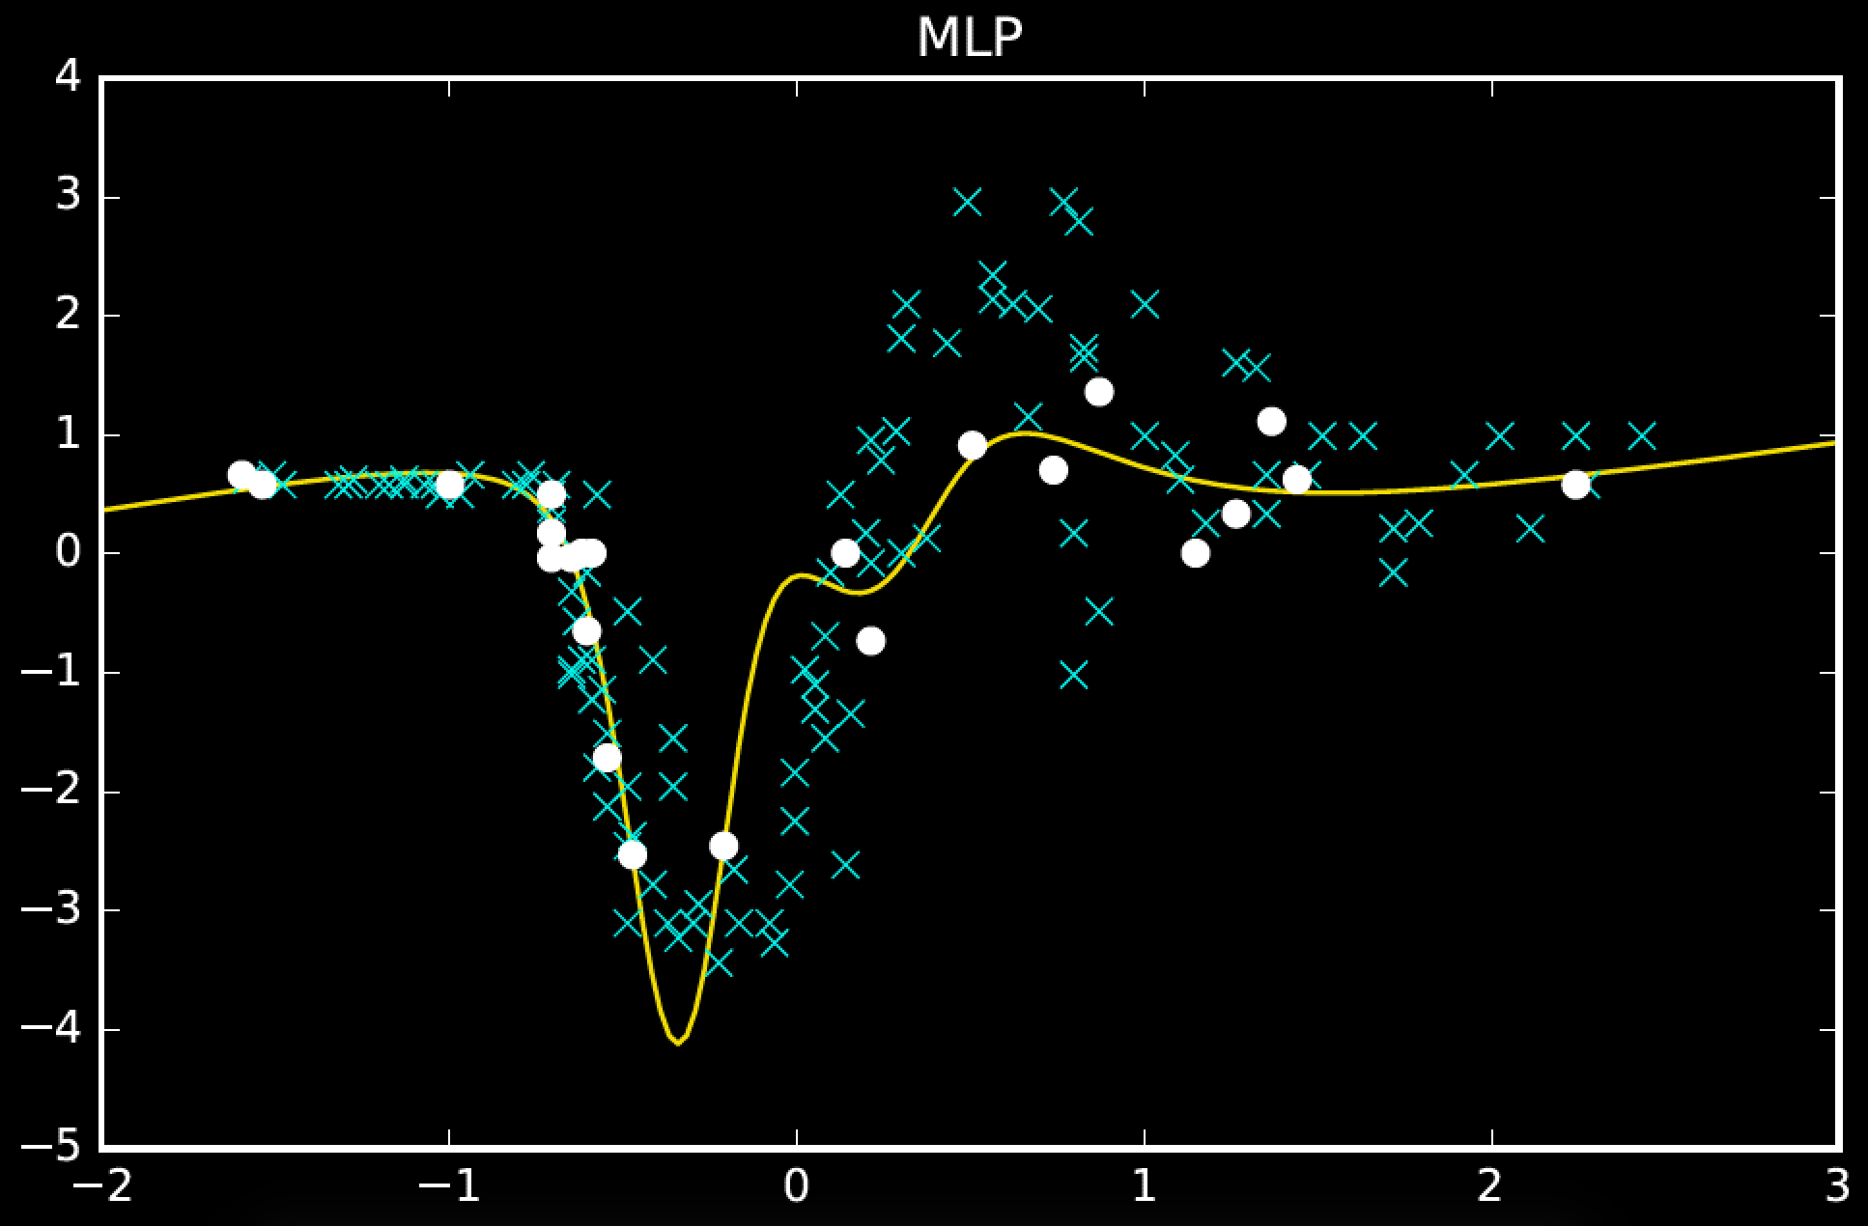

Slide 23
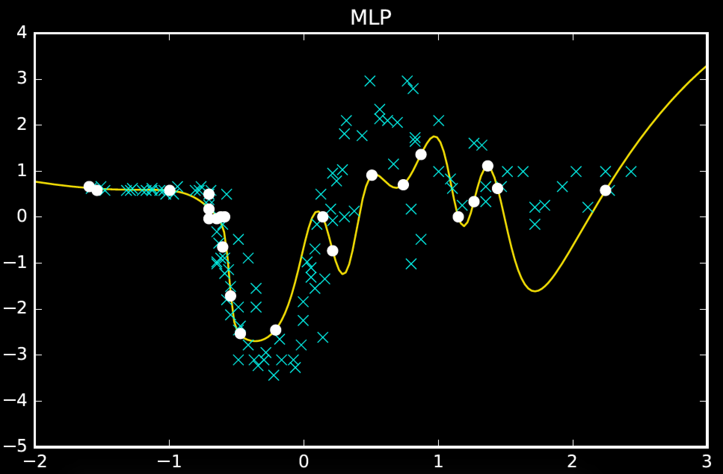

Slide 24
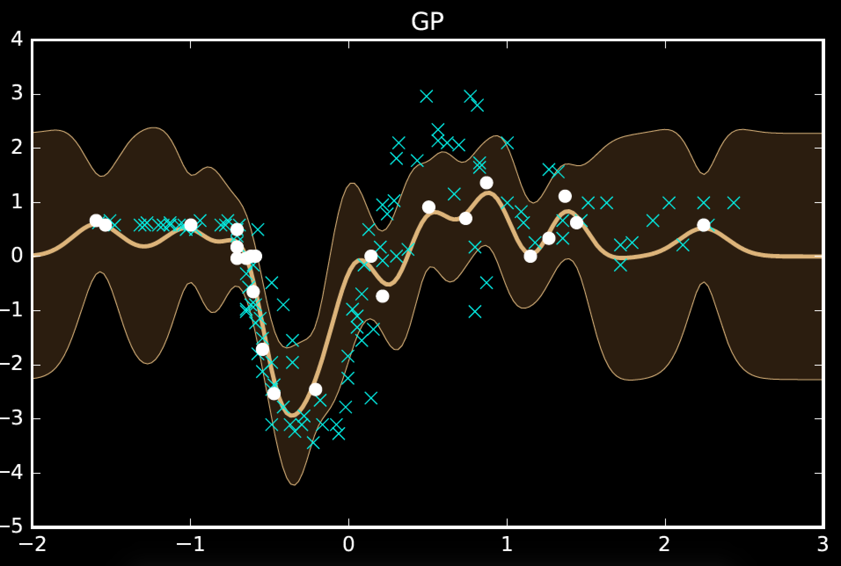

Slide 25
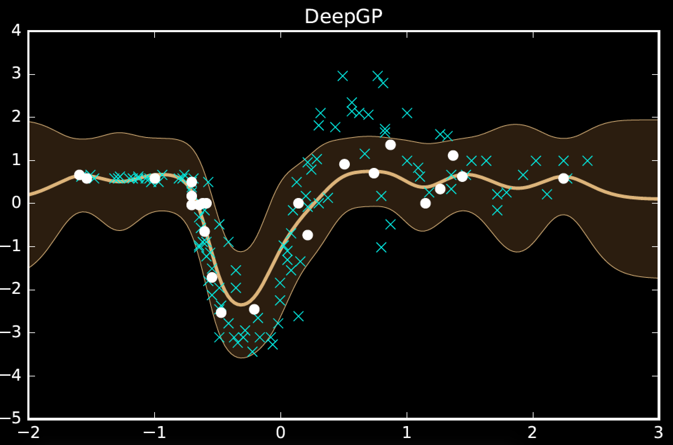

Slide 26
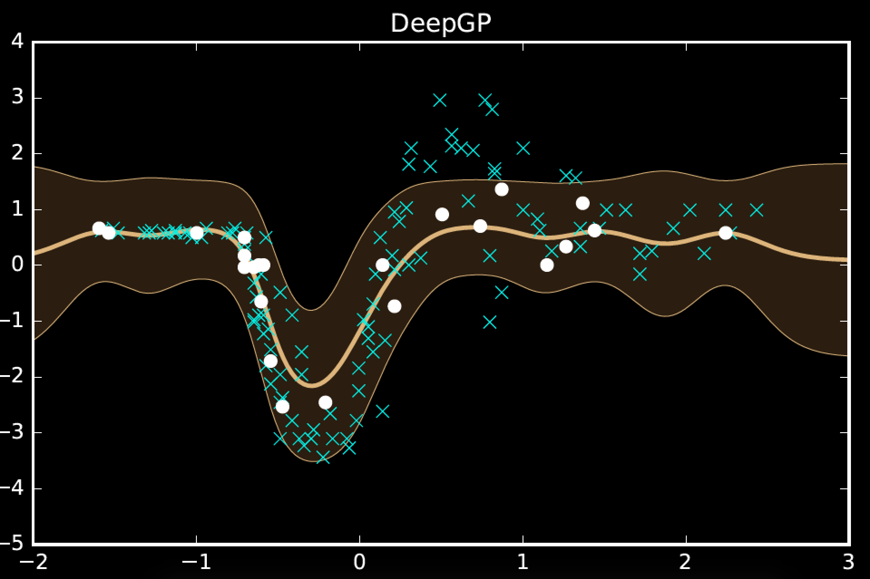

Slide 27
model | MSE (train) | MSE (test)
mlp (200 iters) | 108.5 | 1185.1
mlp (converged) | 24.0 | 1338.2
gp | 59.2 | 1095.4
deep gp (2) | 146.2 | 833.7
deep gp (3) | 182.5 | 843.6
One hundred hidden nodes, one hundred inducing points

Slide 28
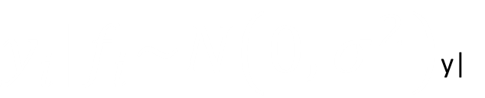

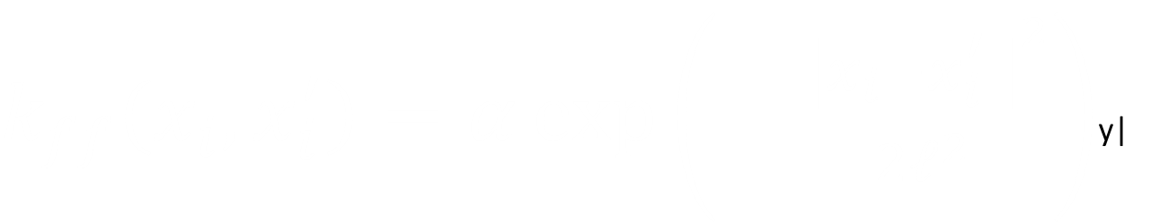
$$f|x\sim N\left(0, K_{ff}\right)$$
$k_{ff}\left(x_{i}, x_{i}^{′}\right)=α\exp\left(−\frac{{\left\|x_{i}−x_{i}^{′}\right\|}^{2}}{2ℓ^{2}}\right)$y|
$y_{i}|f_{i}\sim N\left(0, σ^{2}\right)$y|

Slide 29



$$x$$
$$p\left(y,f | x\right)=\prod_{i=1}^{n}{p\left(y_{i} | f_{i}\right)}p\left(f | x\right)$$
f
y
$$p\left(y|x\right)=\int{\prod_{i=1}^{n}{p\left(y_{i} | f_{i}\right)}p\left(f | x\right)df}$$

Slide 30
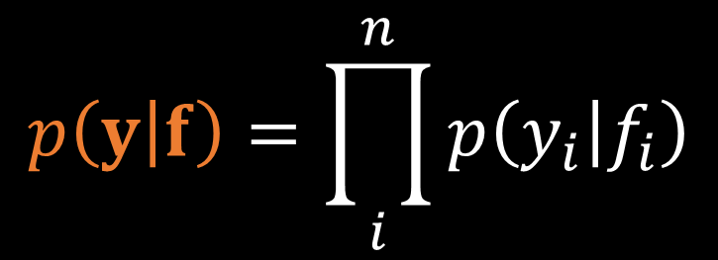


$$x$$
$$p\left(y,f,u\right)=p\left(y | f\right)p\left(u | f\right)p\left(f|x\right)$$
$$p\left(y,f,u\right)=p\left(y | f\right)p\left(f | u,x\right)p\left(u\right)$$
$$x$$
u
f
$$p\left(y | f\right)=\prod_{i}^{n}{p\left(y_{i} | f_{i}\right)}$$
y
u
$p\left(y|u,x\right)p(u)=∫p\left(y | f\right)p\left(f | u,x\right)dfp(u)$

Slide 31
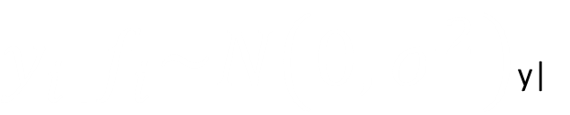

$$f, u |x\sim N\left(0, \left[\begin{matrix}K_{ff} & K_{fu} \\ K_{uf} & K_{uu}\end{matrix}\right]\right)$$
$y_{i}|f_{i}\sim N\left(0, σ^{2}\right)$y|

Slide 32



$$p\left(y | u\right)=N\left(y | m, C+σ^{2}I\right)$$
$$C=K_{ff}−K_{fu}K_{uu}^{−1}K_{uf}$$
$$m=K_{fu}K_{uu}^{−1}u$$

Slide 33
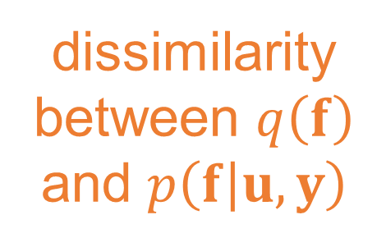

dissimilarity between $q\left(f\right)$ and $p\left(f | u,y\right)$
expected
log likelihood
$$ℒ\left(y | u,x\right)={\left\langle \sum_{i=1}^{n}{{\left(y_{i}−f_{i}\right)}^{2}}\right\rangle }_{q\left(f\right)}−KL\left(q\left(f\right)|p\left(f | u,y\right)\right)+const$$
$$ℒ\left(y | u,x\right)={\left\langle \log{p\left(y_{i} | f_{i}\right)}\right\rangle }_{q(f_{i})}−KL\left(q\left(f\right)|p\left(f | u,y\right)\right)$$

Slide 34

$$p\left(y | u,x\right)≥\prod_{i1}^{n}{\exp{∫{p\left(f_{i} | u,x\right)log p\left(y_{i} | f_{i}\right)df}}}$$

Slide 35


$$p\left(y,w | x\right)=\prod_{i=1}^{n}{p\left(y_{i} | w,x\right)}p\left(w\right)$$
$$x$$
w
y
$$p\left(y|x\right)=\int{\prod_{i=1}^{n}{p\left(y_{i} | w,x\right)}p(w)dw}$$

Slide 36



$$p\left(y,u | x\right)=p\left(y | u,x\right)p\left(u\right)$$
$$x$$
u
y
$u$ looks like a parameter
but we can change the dimensionality of $u$
$$p\left(y|x\right)=∫p\left(y | u,x\right)p(u)du$$

Slide 37
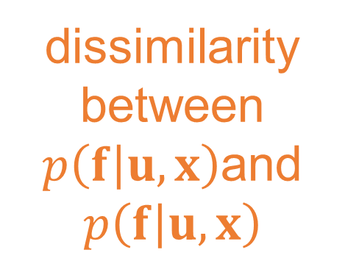
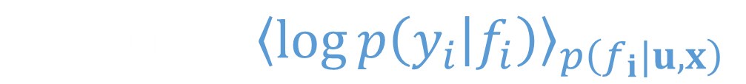

dissimilarity between $p\left(f | u,x\right)$and $p\left(f | u,x\right)$
expected
log likelihood
$$ℒ\left(y | u\right)={\left\langle \log{p\left(y_{i} | f_{i}\right)}\right\rangle }_{p\left(f_{i}|u,x\right)}−KL\left(p\left(f | u,x\right)|p\left(f | u,x\right)\right)$$
$$ℒ\left(y | u\right)={\left\langle \log{p\left(y_{i} | f_{i}\right)}\right\rangle }_{p\left(f_{i}|u,x\right)}$$
choice of $p\left(f | u\right)$ as variational distribution

Slide 38





$$\hat{p}\left(y | u,x\right)=N\left(y | m, σ^{2}I\right)\exp\left(\frac{c_{ii}}{2σ^{2}}\right)$$
$$p\left(y | u,x\right)≥N\left(y | m, σ^{2}I\right)\exp\left(\frac{c_{ii}}{2σ^{2}}\right)$$
$$c_{ii}=k_{ii}−k_{iu}K_{uu}^{−1}k_{ui}$$
$$m=K_{fu}K_{uu}^{−1}u$$
model is linear in $u$

Slide 39
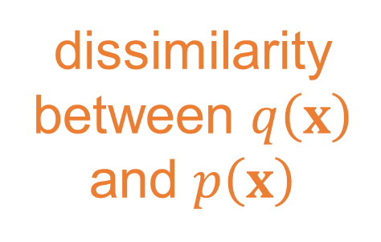

dissimilarity between $q\left(x\right)$ and $p\left(x\right)$
expected
log likelihood
$$ℒ\left(y | u\right)={\left\langle \log{\hat{p}\left(y | u,x\right)}\right\rangle }_{q\left(x\right)}−KL\left(q\left(x\right)|p(x)\right)$$
model remains linear in $u$

Slide 40



$$\hat{p}\left(y | u,x\right)=N\left(y | m, σ^{2}I\right)\exp\left(\frac{c_{ii}}{2σ^{2}}\right)$$
$$p\left(y | u,x\right)≥N\left(y | m, σ^{2}I\right)\exp\left(\frac{c_{ii}}{2σ^{2}}\right)$$
$c_{ii}=k_{ii}(x_{i},x_{i})−k_{iu}(x_{i})K_{uu}^{−1}k_{ui}$ $(x_{i})$
$$m\left(x\right)=K_{fu}\left(x\right)K_{uu}^{−1}u$$
model is not linear in $x$

Slide 41



expected variance of the process
under point uncertainty
$${\left\langle k_{ii}\left(x_{i},x_{i}\right)\right\rangle }_{q\left(x_{i}\right)}$$
$${\left\langle K_{fu}\left(x\right)\right\rangle }_{q\left(x\right)}$$
expected covariation of data with
inducing variables
$${\left\langle {K_{uf}\left(x\right)K}_{fu}\left(x\right)\right\rangle }_{q\left(x\right)}$$
2nd moment of covariation of data
wit inducing variables

Slide 42
$\text{g}\left(x\right)$
${\text{f}}_{1}(x)$
${\text{f}}_{2}(∙)$
${\text{f}}_{3}(∙)$
${\text{f}}_{4}(∙)$
${\text{f}}_{5}(∙)$
${\text{f}}_{6}(∙)$
${\text{f}}_{7}(∙)$
${\text{f}}_{8}(∙)$
${\text{f}}_{9}(∙)$
$\text{g}\left(x\right)={\text{f}}_{9}\left({\text{f}}_{8}\left({\text{f}}_{7}\left({\text{f}}_{6}\left(⋯\right)\right)\right)\right)$

Slide 43

two Gaussian processes: apply bound recursively
$$∫p\left(y | f_{5}\right)p\left(f_{5} | f_{4}\right)p\left(f_{4} | f_{3}\right)p\left(f_{3} | f_{2}\right)p\left(f_{1} | x\right)df$$
$$∫p\left(y | f_{5}\right)p\left(f_{5} | f_{4}\right)p\left(f_{4} | f_{3}\right)p\left(f_{3} | f_{2}\right)p\left(f_{1} | x\right)df$$
$\text{g}\left(x\right)={\text{f}}_{5}\left({\text{f}}_{4}\left({\text{f}}_{3}\left({\text{f}}_{2}\left({\text{f}}_{1}\left(x\right)\right)\right)\right)\right)$

Slide 44
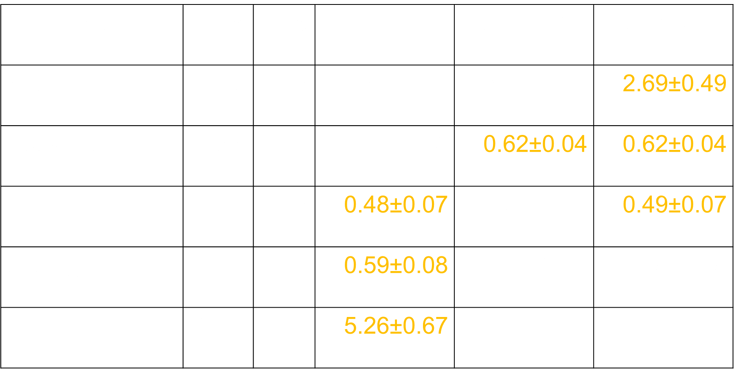
Regression
data set | $$n$$ | $$p$$ | GP | Sparse GP | Deep GP
housing | 506 | 13 | 2.78±0.54 | 2.77±0.60 | 2.69±0.49
redwine | 588 | 11 | 0.72±0.06 | 0.62±0.04 | 0.62±0.04
energy1 | 768 | 8 | 0.48±0.07 | 0.50±0.07 | 0.49±0.07
energy2 | 768 | 8 | 0.59±0.08 | 1.66±0.21 | 1.39±0.49
concrete | 1030 | 8 | 5.26±0.67 | 5.81±0.62 | 5.66±0.62

Slide 45
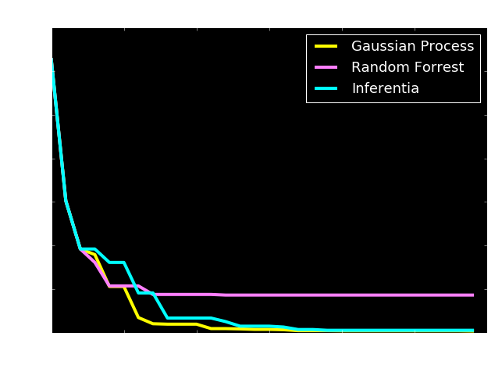
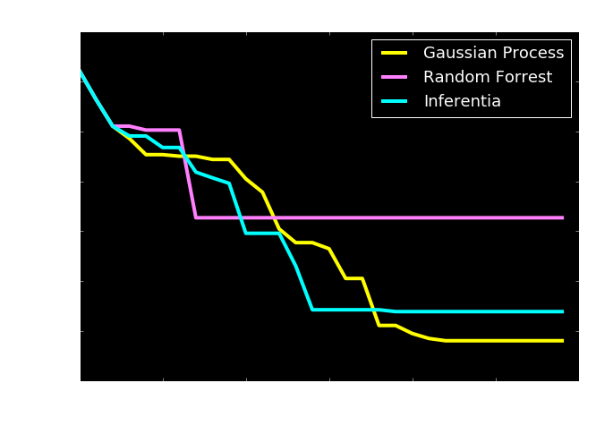
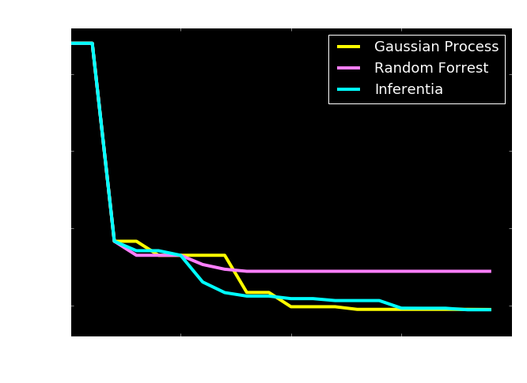
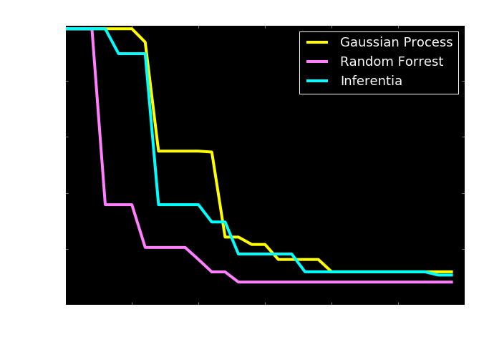
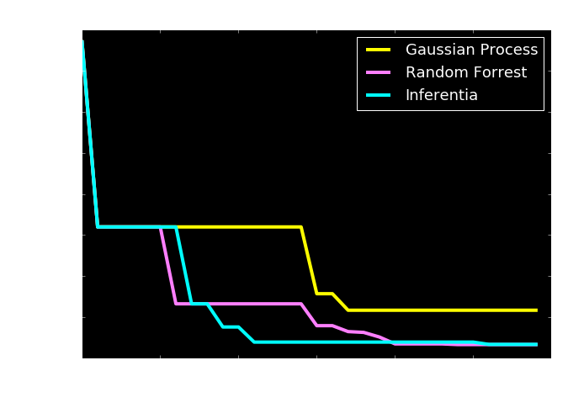
Bayesian Optimization

Slide 46
Example: Motion Capture Modelling
Notes:
I’ll give a quick demonstration of the deep Gaussian process (or show a video) probably on the motion capture. This one involves walkers and runners.

Slide 47
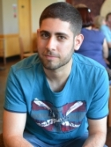
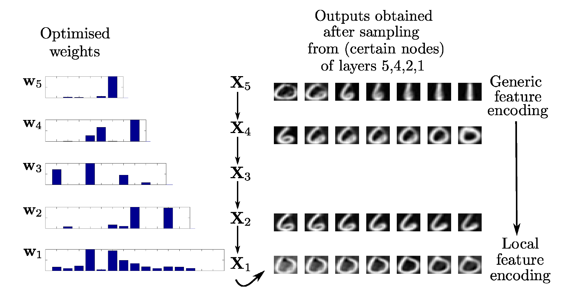
Modelling Digits
Notes:
This one involves a structure that is learnt to model digits.

Slide 48


Slide 49
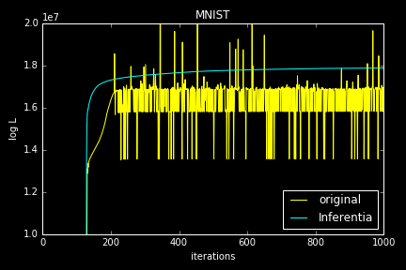
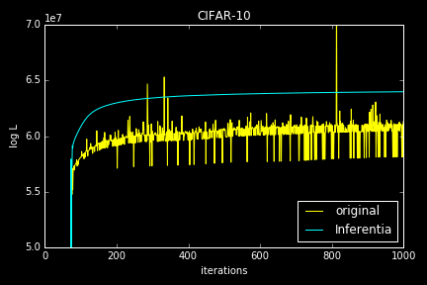
Numerical Issues

Slide 50

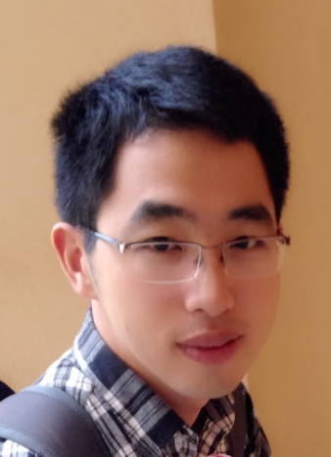

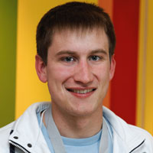
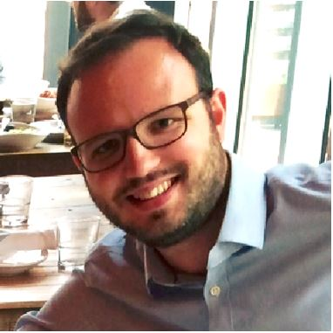
Health
Complex system
Scarce data
Different modalities
Poor understanding of mechanism
Large scale
genotype
environment
epigenotype
State of health
clinical tests
gene expression
Organ states
treatment
clinical notes
Cell states
survival analysis
PLoS Comp Bio, Nature Communications
biopsy
X-ray
biopsy
X-ray

Slide 51
Thank you
Neil Lawrence
http://inverseprobability.com
@lawrennd
Notes:
Thank you.

